Slide 1

CIST 2931, Fall 2016 Weekly Report #4 10/24/2016
i c i o u s
Cnrl/alt/Delicious
Steven Alcorn, Zachary Weaver, Tyrus Skipper, Antonio Mosquera, Rupa Shrestha

Slide 2
Tests
i c i o u s
Performing tests to figure out how to fix the reject button for the Note Auditor.
Testing the changes in code for removing a goal from a participant.
Notes:
Antonio

Slide 3
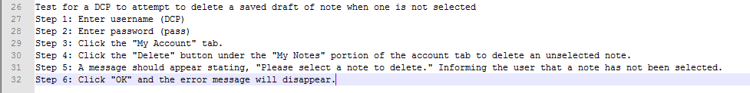
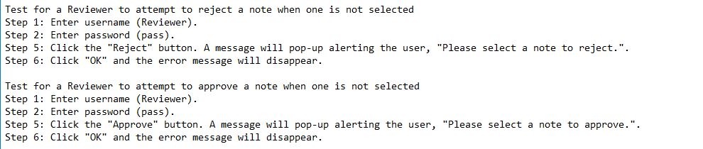
Tests
i c i o u s
Notes:
Antonio

Slide 4
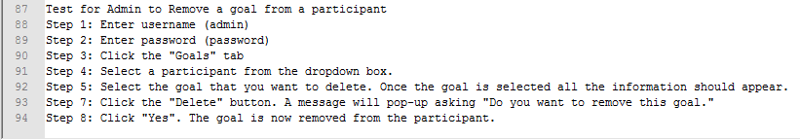
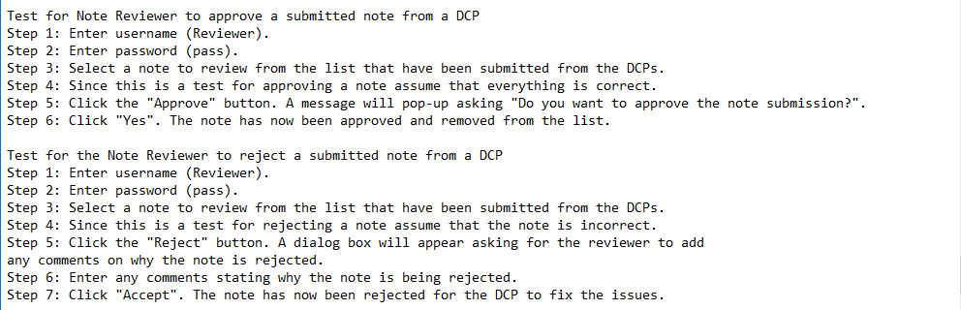
Notes:
Antonio

Slide 5
Code
i c i o u s
Added functionality to the remove goal button under the “Goals” tab for the Admin.
Modified the Text variable in the Database to BLOB to store a larger text document from a DCP
Added code to the application to make it full screen after logging on:
setExtendedState(JFrame.MAXIMIZED_BOTH);
- Added an About section under the Help tab
Notes:
Ty

Slide 6
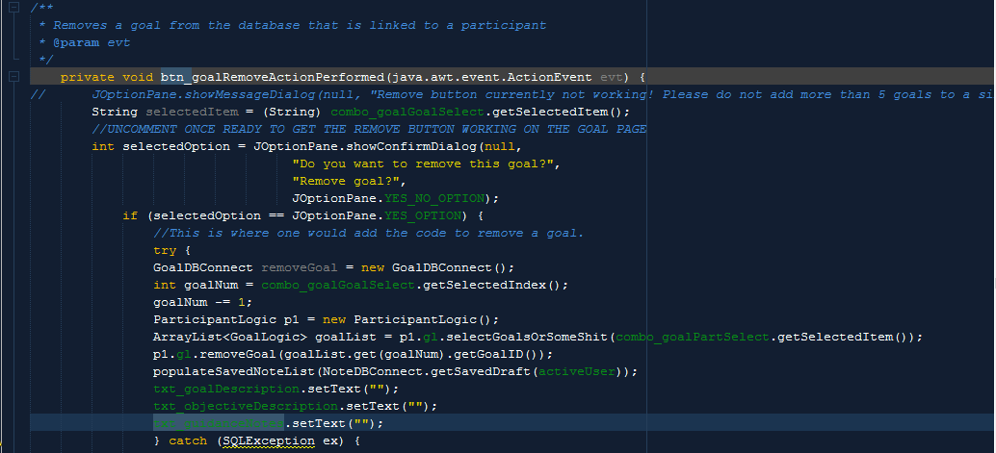
Code
i c i o u s
Notes:
Ty

Slide 7
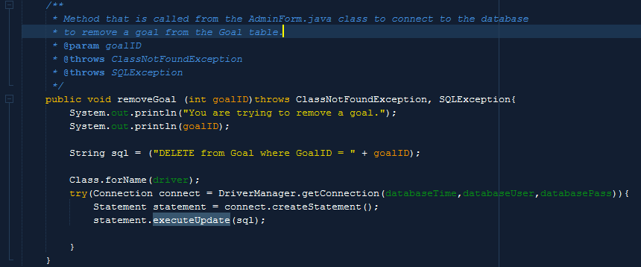
Code
i c i o u s
Notes:
Ty

Slide 8
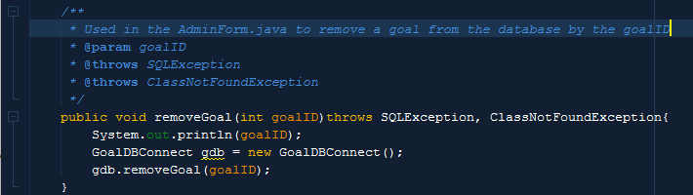
Code
i c i o u s
Notes:
Ty

Slide 9
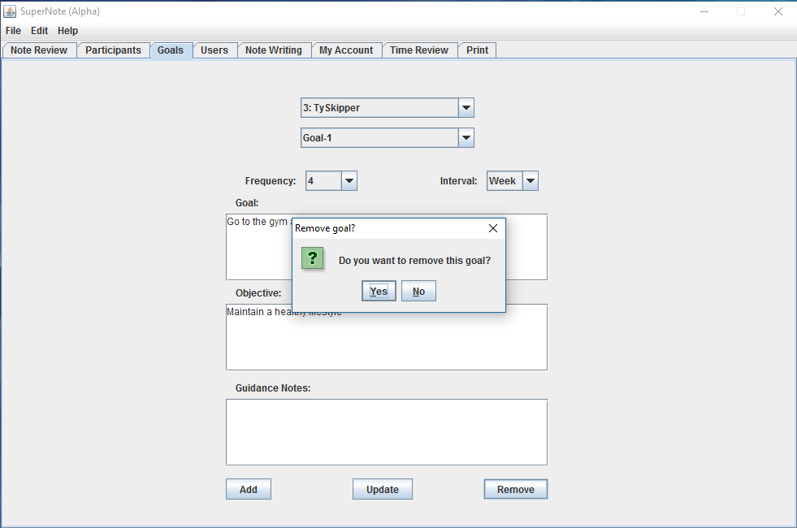
Code
i c i o u s
Notes:
Ty

Slide 10
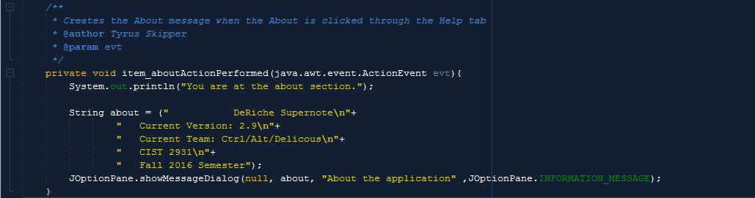
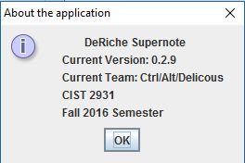
Code
Notes:
Ty

Slide 11
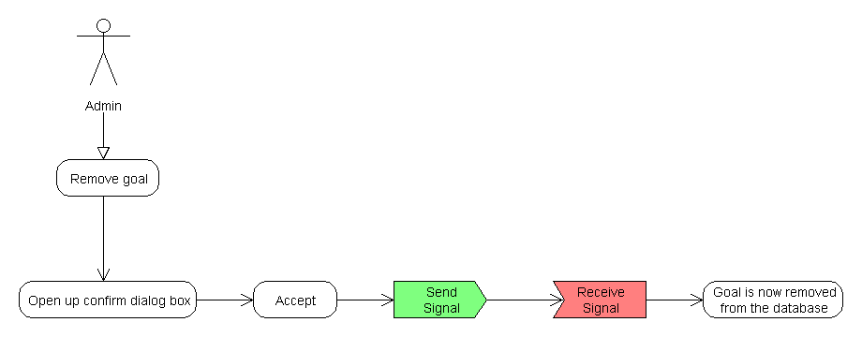
Deliverable
i c i o u s
Notes:
Steven

Slide 12
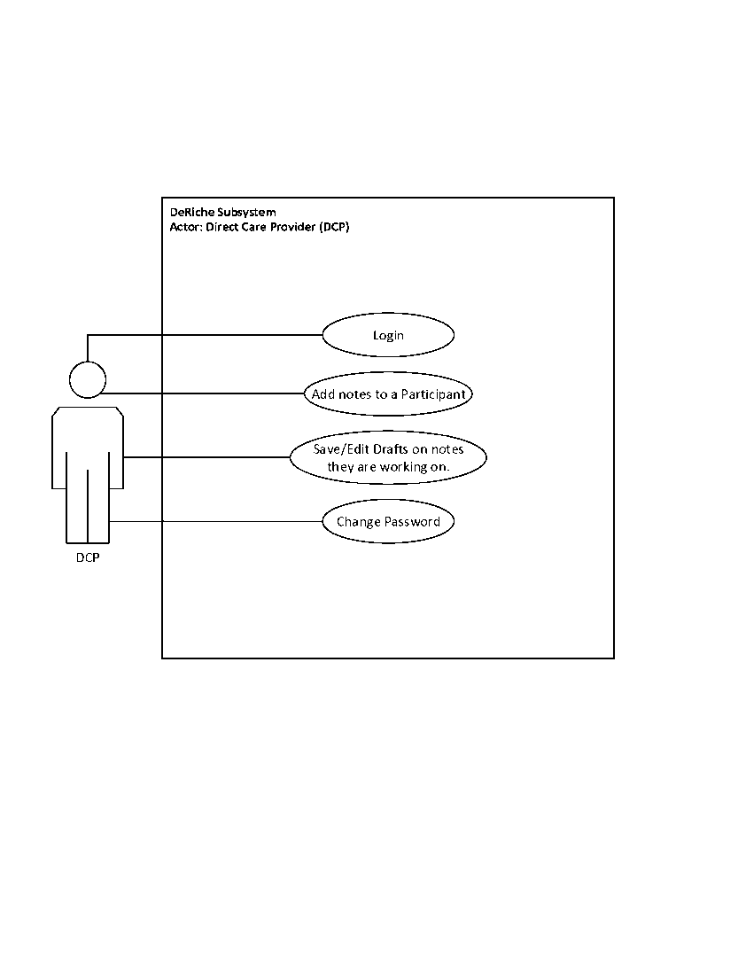
Deliverables
Notes:
Zach

Slide 13
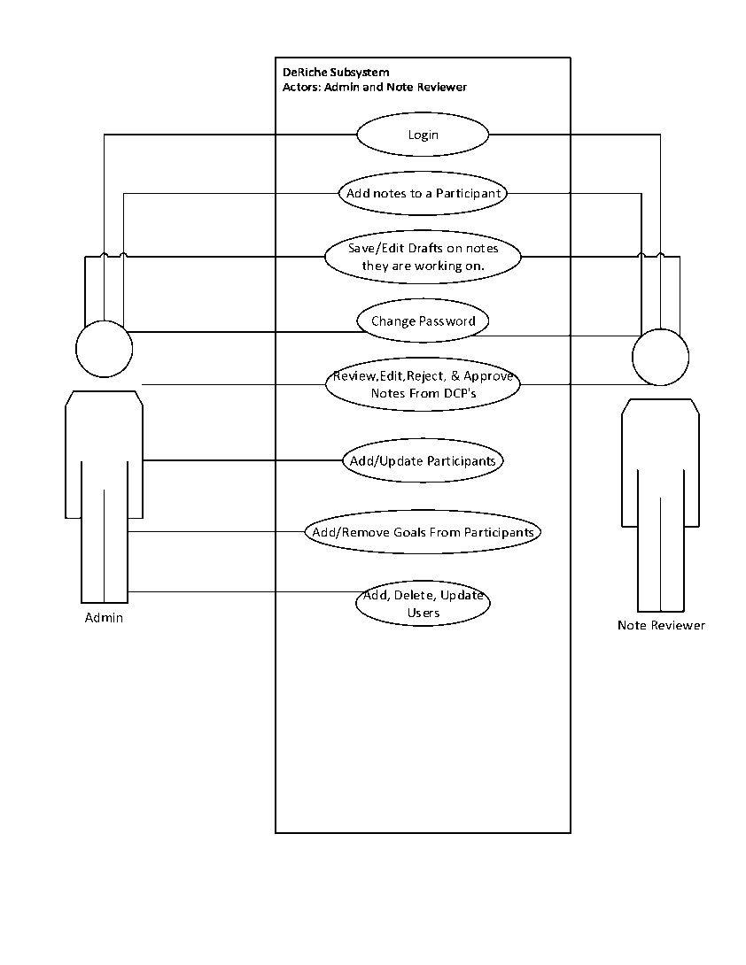
Deliverables
Notes:
Zach

Slide 14
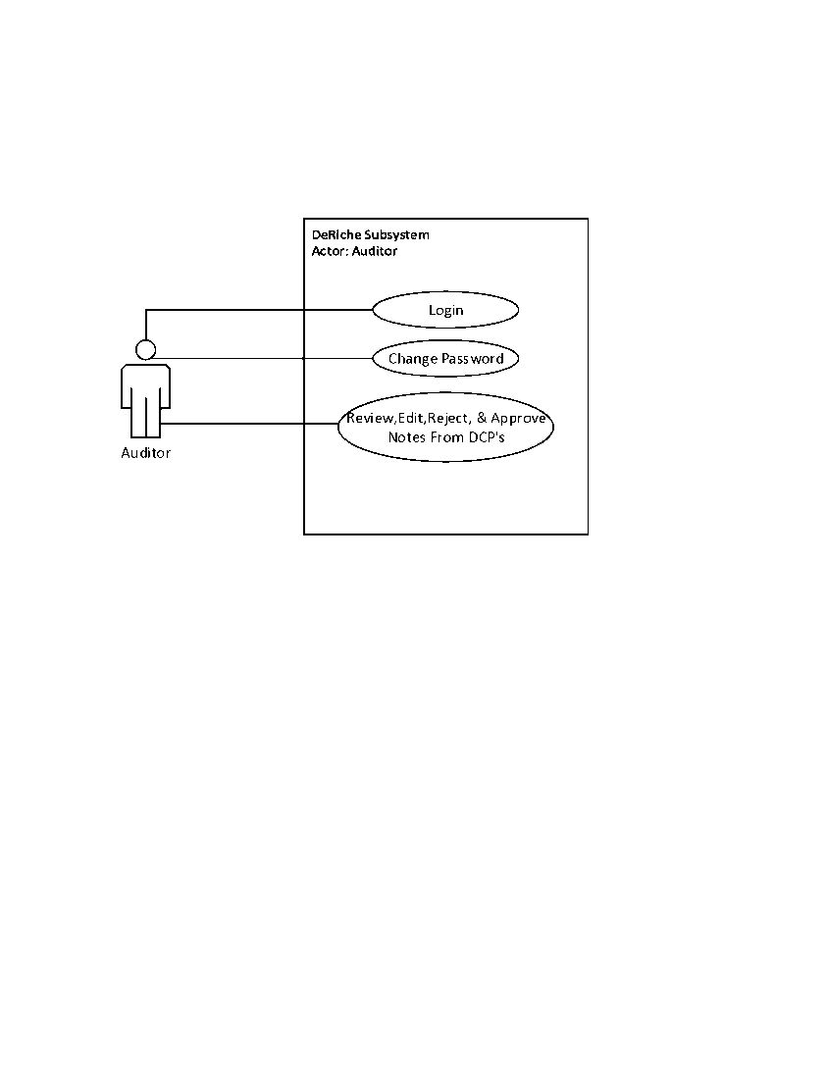
Deliverables
Notes:
Zach

Slide 15
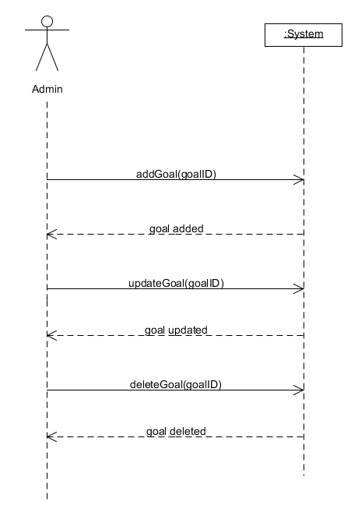
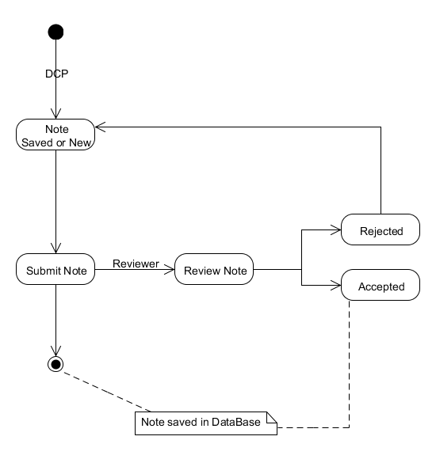
Deliverables
Notes:
Rupa

Slide 16
Project Plan
i c i o u s
Finish the Reject button for the Note Reviewer during tonight’s class.
Start brainstorming on deliverables and ideas on how to allow the application to print a note.
Notes:
Ty

Slide 17
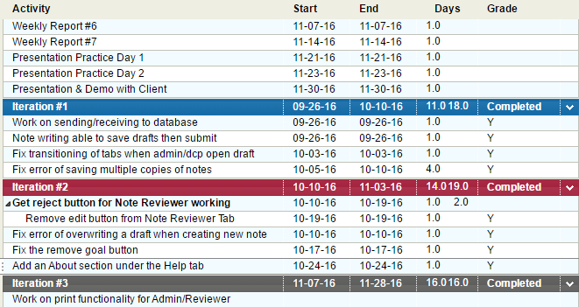
Project Plan for the Semester
Notes:
Ty

